Slide 1
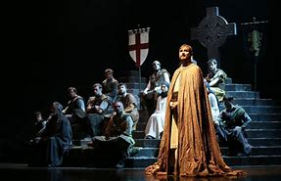
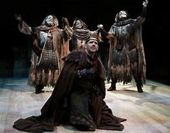
MACBETH
CLASSE 4AFM 2

Slide 2
I think this image represents perfectly my feelings. The image on the left shows that it was beautiful in terms of viewing, settings and actors. The image on the right shows how difficult it was to understand the words and keep the thread of the conversation.
-Matteo C.

Slide 3
This image represents me fully. Like many people unfortunately I sometimes have prejudices. . In fact, before going to the theatre I was very skeptical,
I thought it would be a boring play, performed by unskilled people. This, combined with the lack of love for theatre, discouraged me at the start. Luckily it was not like that. The work was performed excellently, by very good actors. Despite the difficulties with the language I didn’t have too many problems following the plot.
-Marco M.

Slide 4
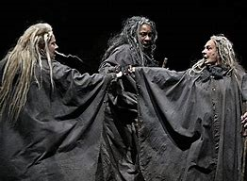
I found this play very interesting even if some parts were very difficult to understand. I think that I understood more because I knew the plot of the play before. I’ve chosen this photo because witches’ parts were easier to understand and I enjoyed them more. Also Lady Macbeth was an interesting character and she acted very well!
-Valeria V.

Slide 5
The world changes when you look at it through the eyes of love. My relationship with English is like love, complicated.
I would have felt this way if I had not known the plot. Knowing the plot helped me to imagine the scenes as I had several difficulties in understanding Shakespeare’s language.
-Angelo B.

Slide 6
I felt sadness because I understood that in everyone there is a feeling and a will of self destruction.
-Andrea G.

Slide 7
Macbeth almost satisfied my gothic soul but unfortunately there wasn’t enough blood and it was a pity not to see the murders because I think they are an important element in the play.
-Michela G.

Slide 8
The play was quite nice and the actors were very good. I think they did their job with love and passion.
Unfortunately I didn’t understand much, especially when they spoke quickly.
-Federico C.

Slide 9
I have chosen this picture because on one hand I really liked the play, the way the actors acted and it was nice to watch, but on the other hand I was disappointed because I expected a more refined exhibition, with more details on the set and in the costumes, and I would have liked to see the scene of Lady Macbeth committing suicide.
-Erica S.

Slide 10
This image shows how I felt during the pLAy…
… I had three fondamental experiences:
I didn’t understand a lot and therefore I was a little bit confused.
The emotions I felt thanks to the actors and their skills.
The pleasure of seeing something beautiful and passionate sitting in a comfortable armchair.
-Marta M.

Slide 11
In my opinion it was a beautiful work, nicely played. Thanks to the work done in class it was easy to understand.
-Hadi N.

Slide 12
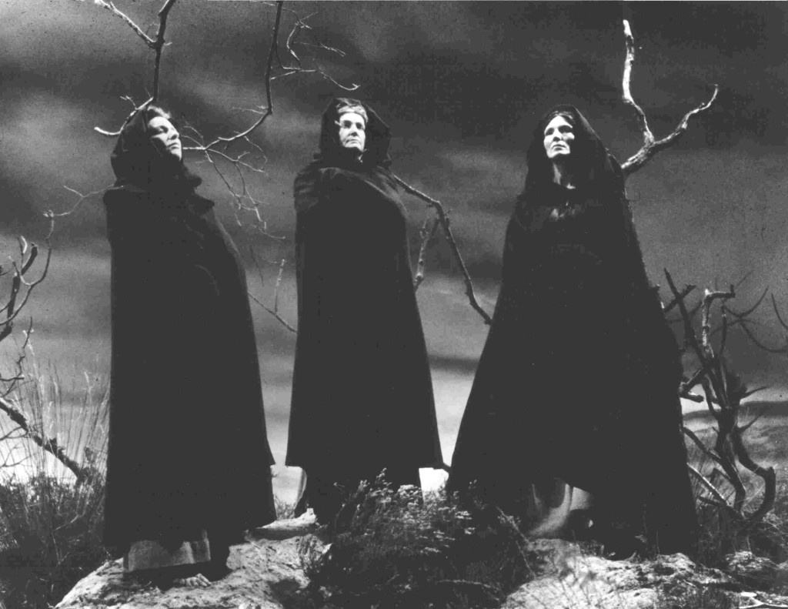
-Yana P.
The play was very beautiful and interesting, but for me it wasn't so easy to understand and some scenes were boring. However what I liked most were the actors playing the witches and Lady Macbeth.

Slide 13
-Luca Z.
It was difficult to understand everything: the actors had strong accents and it was hard to understand their words, but I could guess almost everything because, knowing the plot, it was much easier.

Slide 14
-Mattia b.
I like this image because if I hadn’t read the plot of Macbeth I wouldn’t have been able to understand even the role of the characters.

